Slide 1
Store & monetization
Developer’s guide for
Windows 10 insider preview
Andy & Jerry

Slide 2
One store
Monetization strategies
Advertising
Purchases

Slide 3

Windows store

Slide 4
One store, one catalog
Apps
Including Win32
Music
Video
Xbox Games

Slide 5
Sell your app
One app submission for every device family
One set of merchandising metadata
(coming soon) Subscription pricing
(coming soon) The store is also on the web
(coming soon) Application flighting
Weighted advertising campaigns
Promotional codes
App install ads
House ads

Slide 6
Use house ads to promote your own properties

Slide 7
Windows store packaging
Feature | WP XAP 8.1 | WP AppX 8.1 | AppX 8.1 | AppX 10.x
Platform | WP 8.1+ | WP 8.1 | Win 8.1 | Win 10
Device OS Build version targeting |  |  |  | 
Encryption |  |  |  | (not yet)
App Bundles |  |  |  | 
Debug Package Signing |  |  |  | 
Differential Download/Update |  |  |  | 
File Single Instancing |  |  |  | 
External Volume (SD) Installation |  |  |  (Win 10) | 
Shared publisher storage |  |  |  | 

Slide 8
Windows store distribution
 | Windows Phone 7.x, 8.x | Windows 8.x | Windows 10
Hidden apps |  |  | 
Per market pricing |  |  | 
Independent IAP publishing |  |  | 
Betas / flighting |  |  | 
Time based trials |  |  | 
App discounts |  |  | 
Scheduled publish |  |  | 

Slide 9
What about businesses?

Slide 10
Participating in Business Store
Apps published to the Public Store are listed in the Business Store automatically
Businesses can purchase in bulk
Opt-in to offline licensing for your app
Support scenarios where target devices are disconnected from the internet
Privately publish applications to specific businesses
Business portal allows a business to link to your developer account, after which you can select specific apps to be published only to that business, bypassing the public Store

Slide 11
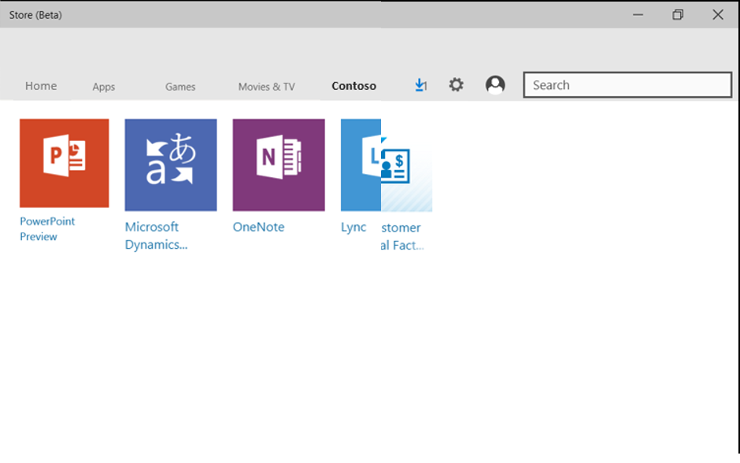
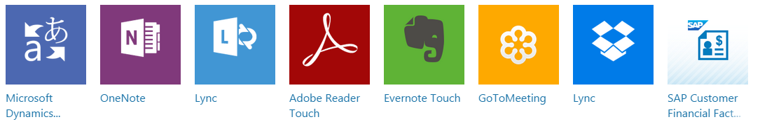

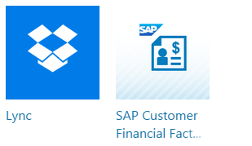
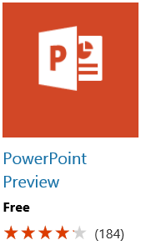

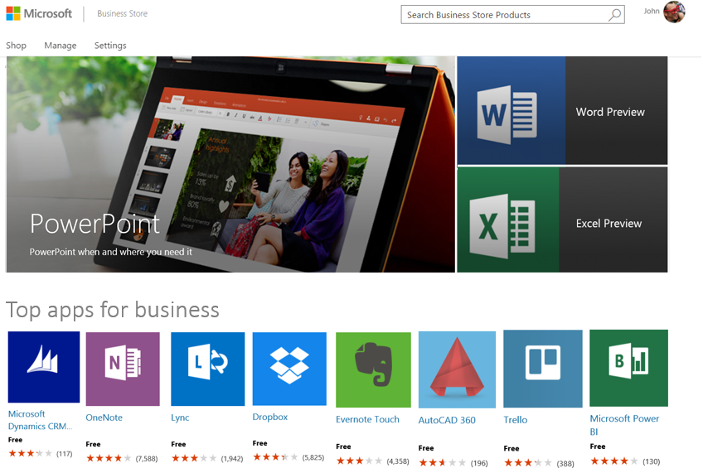
Business Store for Windows 10
Developer reach
Same Dev Center
Seamless for organizations
Organizations can search, acquire, manage and distribute apps in volume
Business Store integrates with management tools

Slide 12

Microsoft advertising

Slide 13
Monetize your app
Application purchase
Time or feature-based trial
App purchase
Advertising
Interstitial video
Advertising broker
In app purchase
Consumable & Durable
(coming soon) Subscription

Slide 14
Advertise your app
Promote your app
Manual or auto-targeting by age, gender, and location
Track and analyze app installs & campaigns
Cross-promote your app for free
Coming soon
Additional targeting features
Third-party analytic support
Increased campaign budget

Slide 15
Store affiliates
Monetize on web properties (blogs)
Earn a 7% commission on apps, games, music, movies and videos
Cross-sell physical & digital goods
Simplified, faster payments

Slide 16
Store payout activity is centralized with lowered thresholds

Slide 17
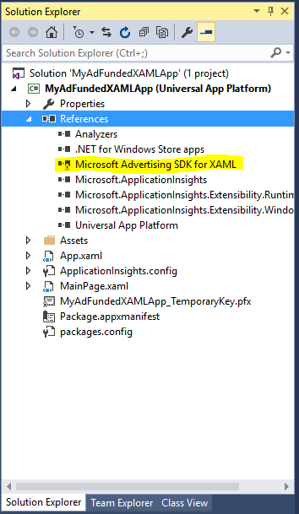
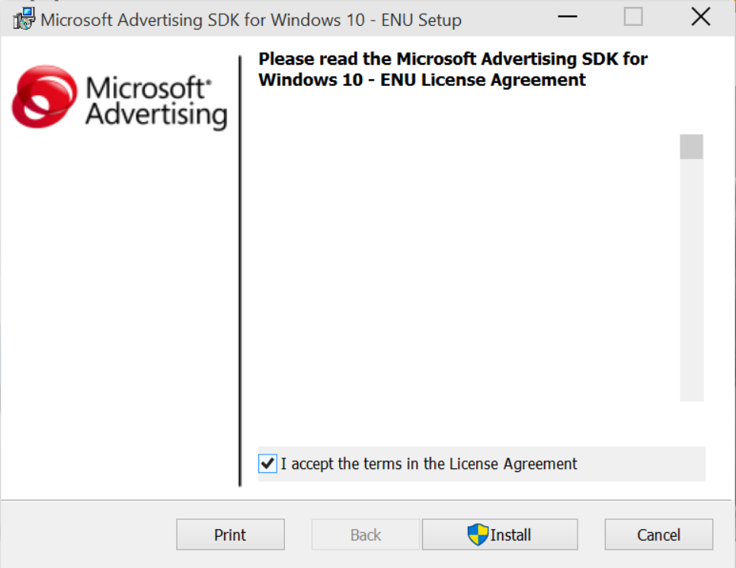
Microsoft advertising SDK

Slide 18
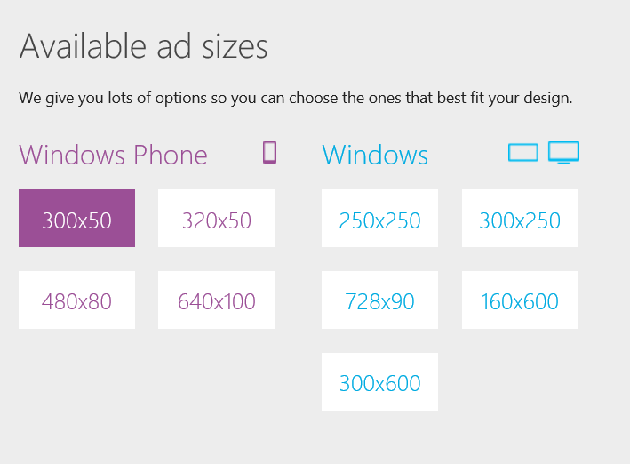

Slide 19
New ad mediation maximizes your fill rate

Slide 20
Video interstitials
Benefits
Integrates naturally
Rewards-based advertising
Availability
Windows 10 universal
Windows/Phone 8.1 (soon)

Slide 21
Video ads
4:00

Slide 22
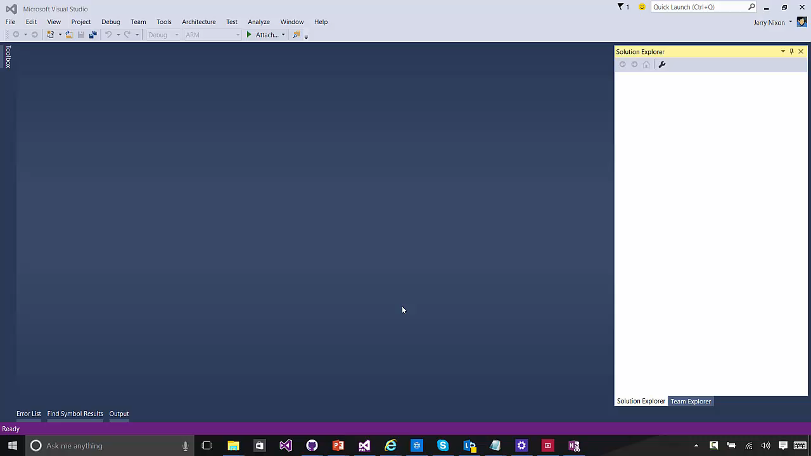

Slide 23
New video interstitials introduce trending approaches

Slide 24
Considerations
Best practices
Consider ads during the design phase
Show video ads during natural breaks
Associate ads with real up-sides
Worst practices
Showing ads at app-start
Interrupt the user’s workflow
Back-to-back ads

Slide 25
In app purchases can be durable and consumable

Slide 26
In app purchase
6:10

Slide 27
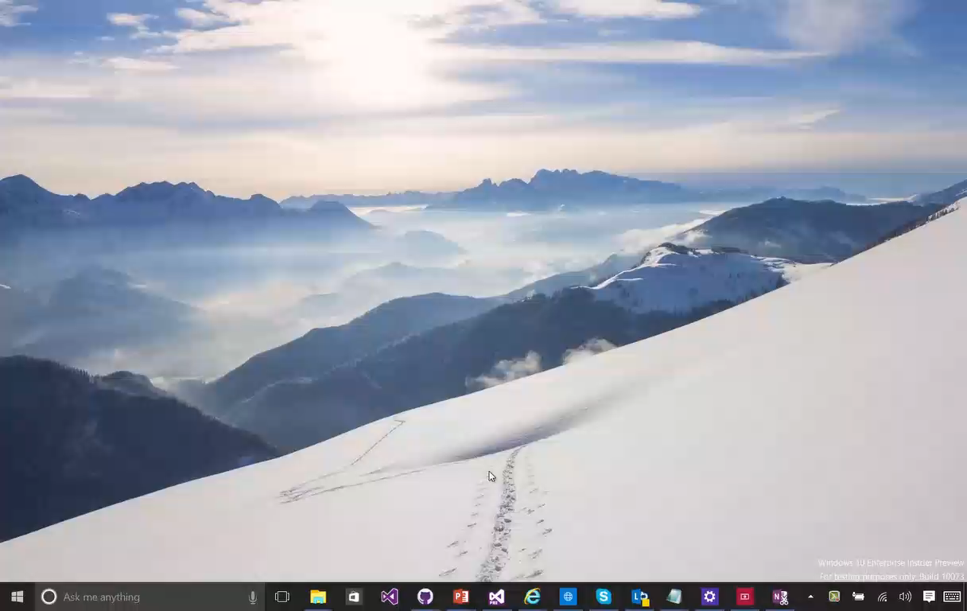

Slide 28
In-app purchases
#if DEBUG
var license = CurrentAppSimulator.LicenseInformation;
if (license.ProductLicenses["AdFree"].IsActive)
{
// already owns
this.ShowAds = false;
}
else
{
var result = await CurrentAppSimulator.RequestProductPurchaseAsync("AdFree");
switch (result.Status)
{
case ProductPurchaseStatus.Succeeded:
case ProductPurchaseStatus.AlreadyPurchased:
this.ShowAds = false;
break;
default:
this.ShowAds = true;
break;
}
}
#else
var license = CurrentApp.LicenseInformation;
...
#endif

Slide 29
The Windows store provides many ways to monetize your app

Slide 30
One store
Monetization strategies
Advertising
Purchases

